Slide 1

Assignment
Presented By:
Sumidha Kumari Prasad

Slide 2
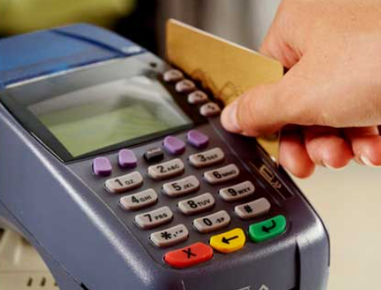
Credit Card
According to data from various sources
- Economics Times,
Global Data
siksha.com
PR-Newswire
PWC
Money Control
Medium
other websites
5% of the Indian Population uses credit card,
hence there is lot of room for future growth.
The main source of revenue for credit card companies are:
processing fee
annual/renewal charges
late fee
hidden charges
interchange fee
foreign transaction charges
card replacement fee

Slide 3
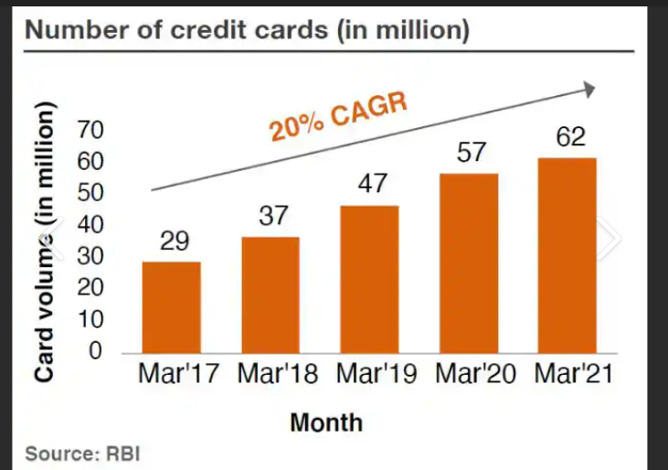
According to RBI data, in April 2023, India had over 8.6 crore credit cards outstanding, a growth of around 15% from 7.5 crore in April 2022.
With the increase in disposable income, more and more people are having credit cards.
GlobalData’s Payment Cards Analytics reveals that card payments value in India registered a strong growth of 26.7% in 2022, supported by improving economic conditions.
This trend is expected to continue in 2023 and India’s card payments market is set to grow at a compound annual growth rate (CAGR) of 18.7% between 2022 and 2026 to reach INR 43.3 trillion ($581.1 billion) in 2026.

Slide 4
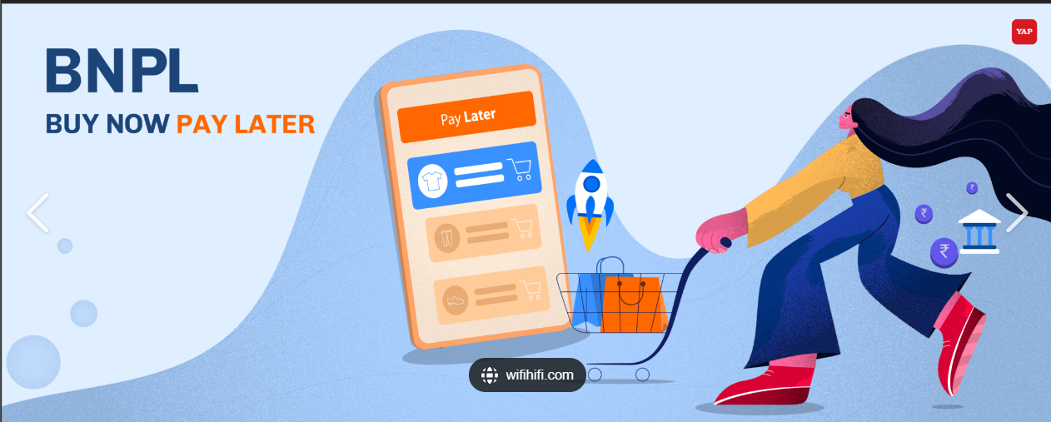
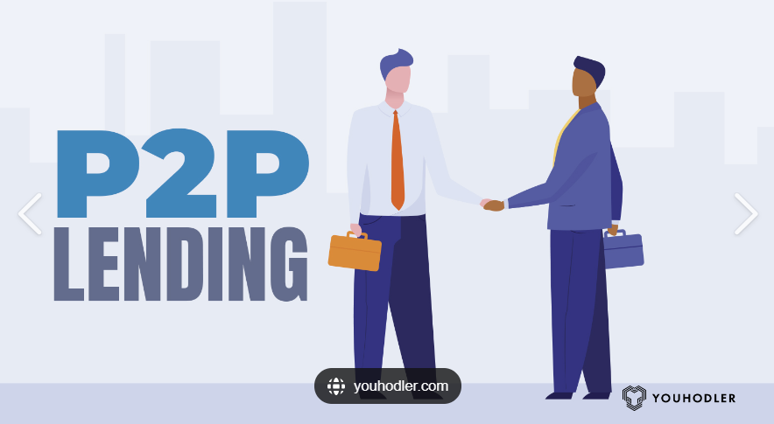
What can disrupt credit card market?
Credit card is one of the earliest modes
of cashless transactions
Credit Card has threat from:
Buy Now Pay Later popularly known as BNPL
Peer to Peer (P2P) Lending

Slide 5
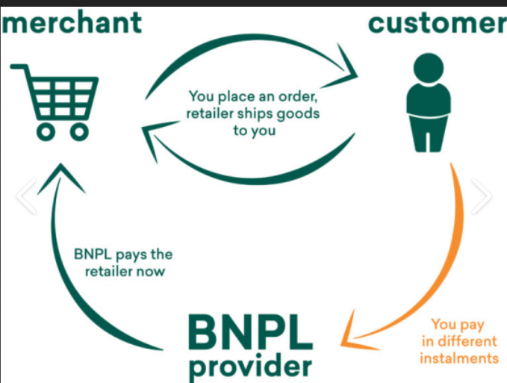
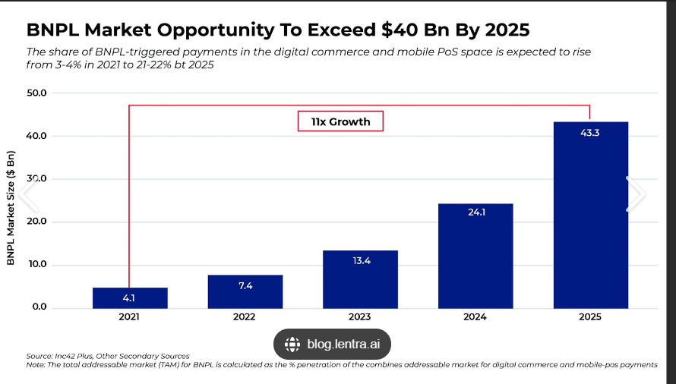
Buy Now Pay Later (BNPL)
For smaller transaction UPI is preferred, for larger transaction Credit card is used
In a short span of time BNPL has captured 3% of India’s online market in online ecommerce market segment.
BNPL is becoming a popular mode of short-term financing amongst millennials.
BNPL tap into large customer database without credit history.
Due to its hassle-free and flexible microcredit and short-term interest-free payment options, BNPL has become extremely popular among millennials.

Slide 6
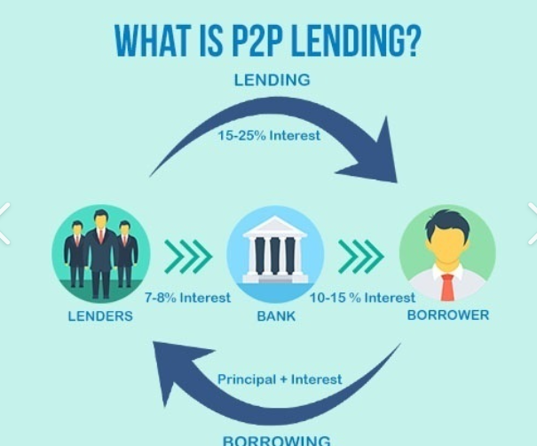
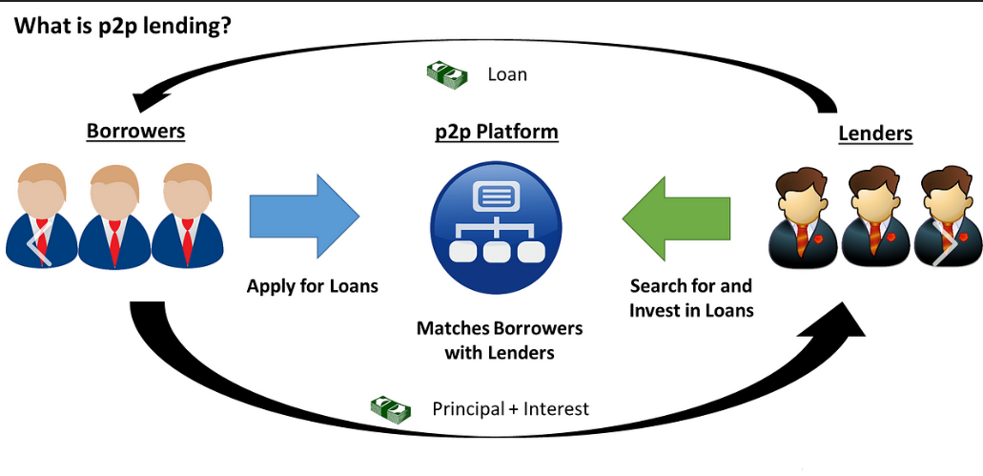
Q1)1.2What can disrupt this market?
P2P Lending
Why P2P?
In P2P Lending, lenders earn a 12-15% interest where as if lenders
do FD in in bank, lender will get around 7-8%.
For Borrowers also its easy to take loan through lenders because
There might be a possibility that Bank would reject its loan
If not found a potential.

Slide 7
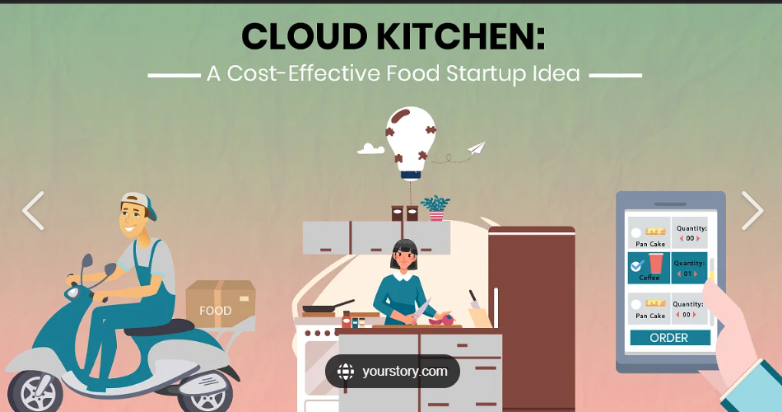
Let’s say I own a Cloud kitchen (make up a hypothetical brand around it)
create a marketing plan around it with a budget of Rs 50 thousand
Assuming
For a Cloud Kitchen,
I am taking an example of fast-food .
I named the cloud-kitchen as Routine-Cafe.
My cloud kitchen is located in HSR Layout, Bengaluru.
Routine-Cafe is listed on all the food delivery app.

Slide 8
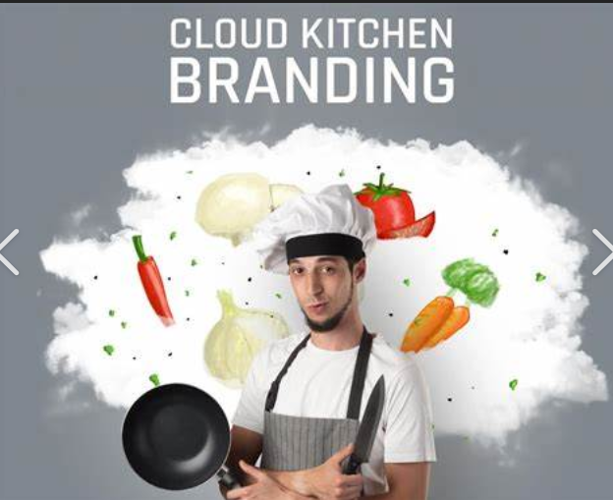
Word of Mouth has always been the best marketing strategy since time immemorial but to reach a wider audience in
a short span of time marketing strategy is required.
Now, I have a budget constraint of INR 50k to spend on
Marketing which will increase my sales.
My Marketing Strategy:
Firstly, I would like to keep cloud kitchen ambience a
decent one.
For this I allocate Rs 10k
Reason: HSR Layout is a startup hub, having a good 23-33 age bracket population.
These people can occasionally come to Routine-Cafe and have basic tea/coffee & snacks.
Crowd will gather More Crowd.

Slide 9
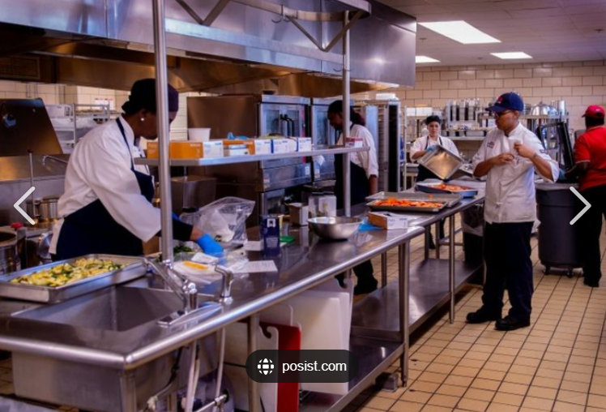
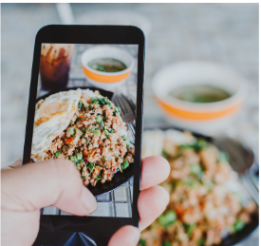
Secondly, I will spend money on Social Media Marketing.
My Budget Allocation would be Rs 15k for Social Media Marketing.
I would choose Instagram to promote Routine-Café.
Why Instagram?
A good number of youth uses Instagram.
Reels trend on Instagram.
Hence, I would like to routinely post reels of different food.
Now-a-days customers care a lot about hygiene. Customers are willing
to pay premium if they will get hygienic food.
Hence, I would share kitchen videos then that
will create an positive impact.

Slide 10
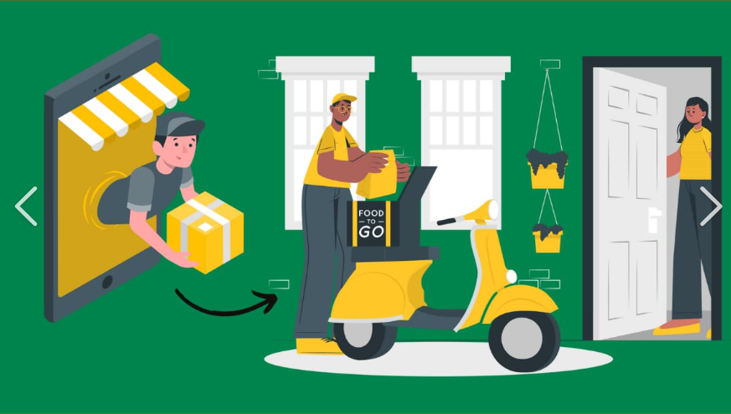
Thirdly, For listing on food delivery apps like Zomato/Swiggy I will allocate Rs 15k.
As a starter customers wont be knowing Routine-Café,
hence I will have to promote my cloud kitchen.
At the end of the day how so ever marketing strategy I apply to get the customers, if the food quality, overall experience of food and service is not good Customer Acquistiton Cost (CAC) will be there but revenue wont be generated by repeated customer.
Hence, marketing strategy along with overall customer experience is important.
Lastly, I would like to run ad on google.
My budget- Rs 10k Why Google Ad? Majority of people uses google to browse.

Slide 11
Hypergro mobile application
My understanding of Hypergro:
It uses AI with Marketing.
It offers services to other companies to increase their revenue.
It Acquires customer via Customer Generated Content(UGC).
It has 3 sections in its app.
Home Section
AI Tool Section
Community Section

Slide 12
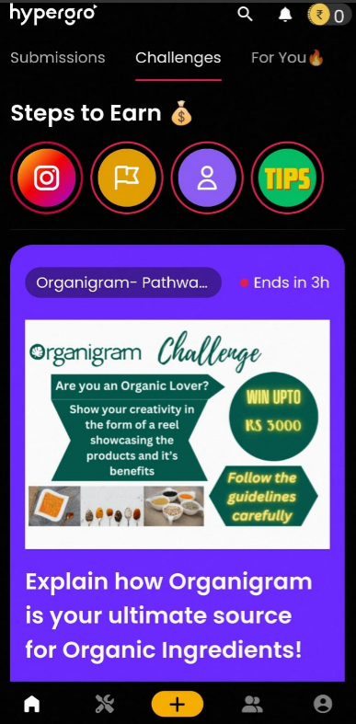
Product tear down of Hypergro mobile application
In the Home section of app there are various challenges hoisted where people can participate and win cash prizes and other goodies.

Slide 13
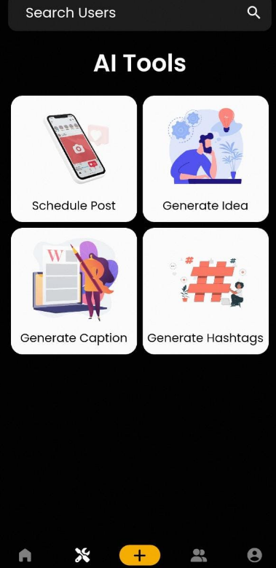
Product tear down of Hypergro mobile application
On the right if home tab is AI tools which people can incorporate in their videos
to take the video to next level with minimal effort as AI tools offer
Schedule post
Generate Idea
Generate Options
Generate Hashtags

Slide 14
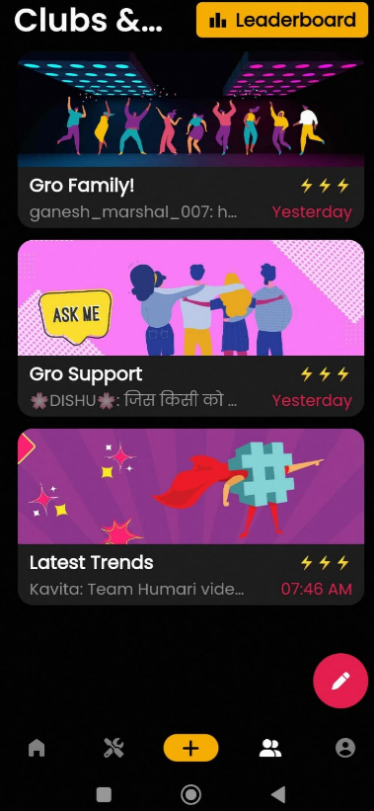
Product tear down of Hypergro mobile application
Hypergro has a community in app
where one can connect with like minded people and network,
learn,support each other.

Slide 15
Thank You

